Slide 1
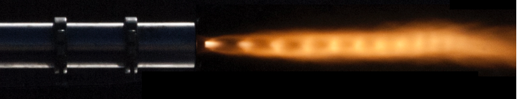


Design of a Vortex End-Burning Hybrid Rocket Engine
26th Annual Arizona Space Grant Symposium
William Templeton
Mentor: Dr. John Rajadas

Slide 2
Overview
Overview of Chemical Rocket Propulsion
Conventional Hybrid Engine Design v. VEBH Design
Oxidizer Injection System
Combustion Mechanics of VEBH
Oxidizer Feed System Development
Motor and Fuel Fabrication
West Campus Engine Testing Shelter
West Campus Testing Site Development

Slide 3
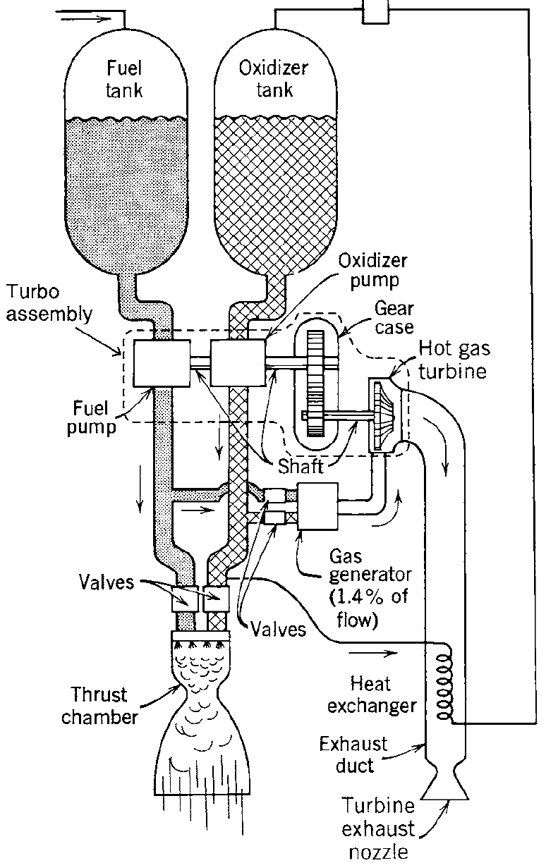
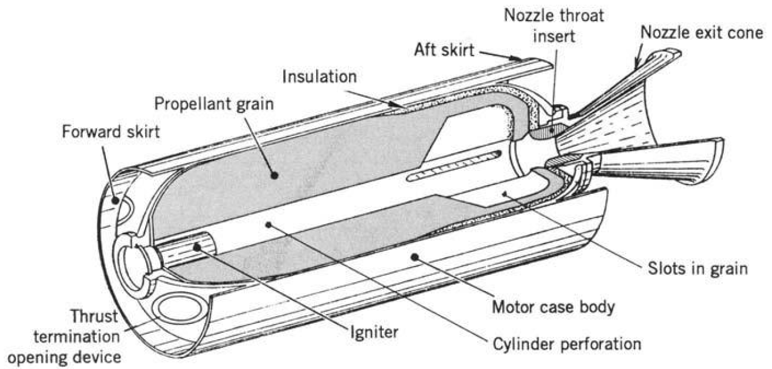
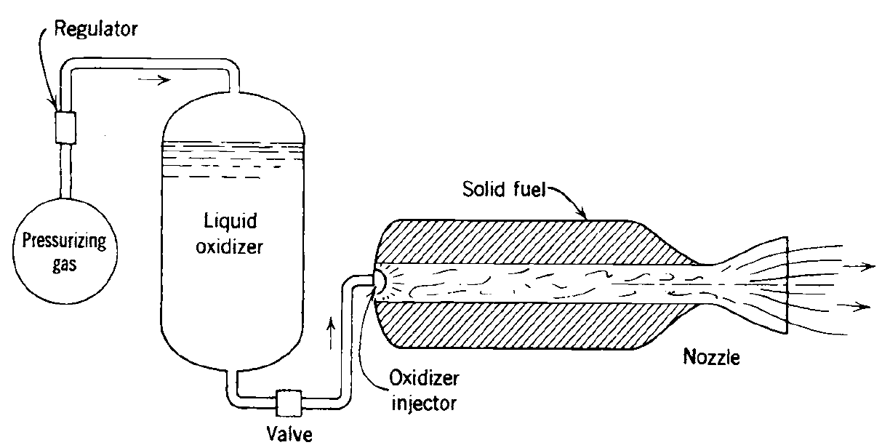
Chemical Rocket Propulsion
Figures from Rocket Propulsion Elements 7th Edition

Slide 4
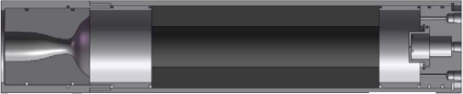
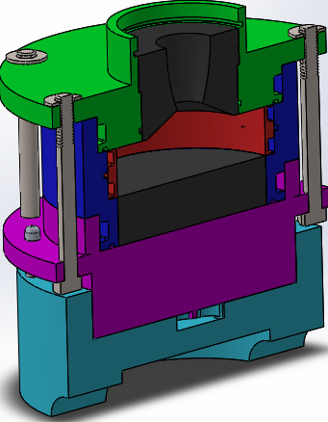
Conventional Hybrid Engine Design v. VEBH Design
Oxidizer Input
Exhaust Out
Fuel
Exhaust Out
Oxidizer Input
Fuel

Slide 5
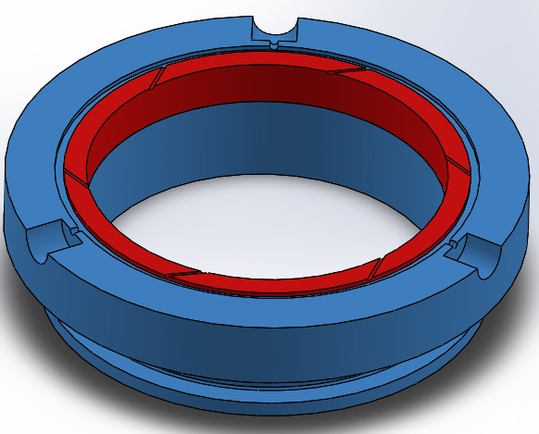
Oxidizer Injection System
Oxidizer Injector Ports
Oxidizer Feed System Input

Slide 6
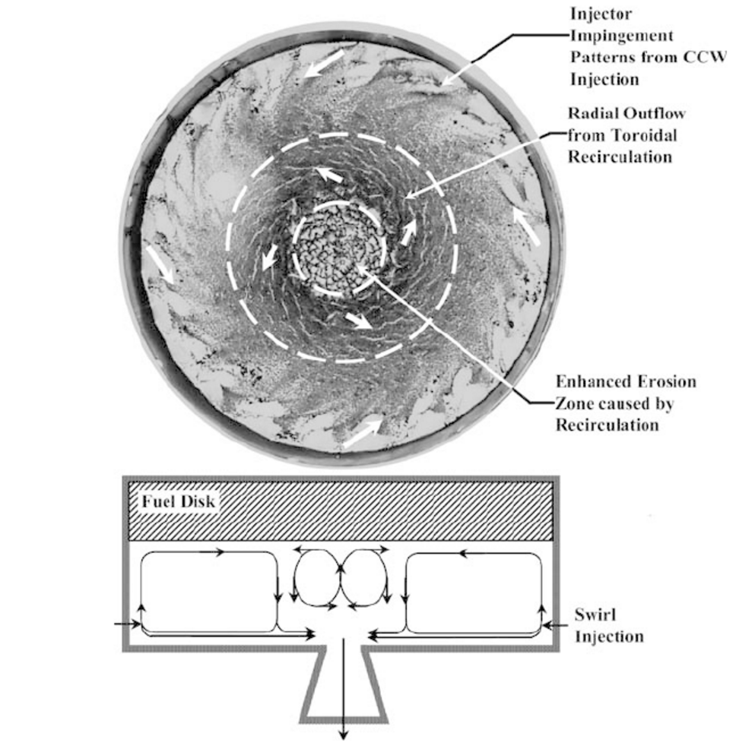
Combustion Mechanics of VEBH
Figure from Fundamentals of hybrid rocket combustion and Propulsion

Slide 7
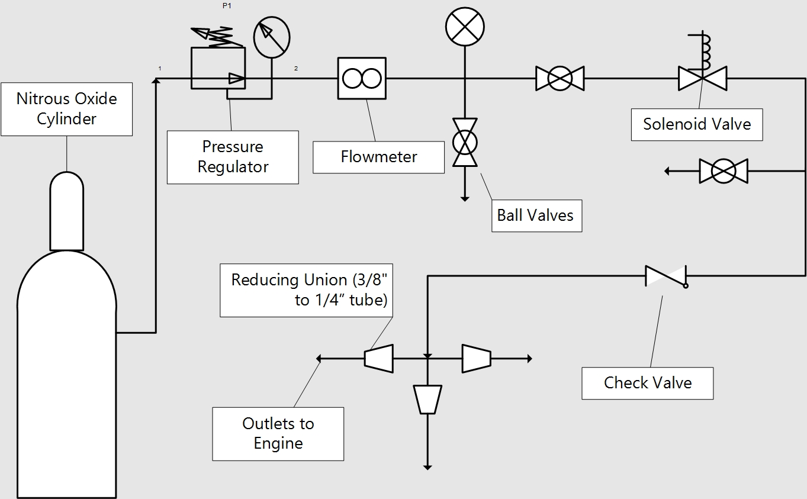
Oxidizer Feed System

Slide 8
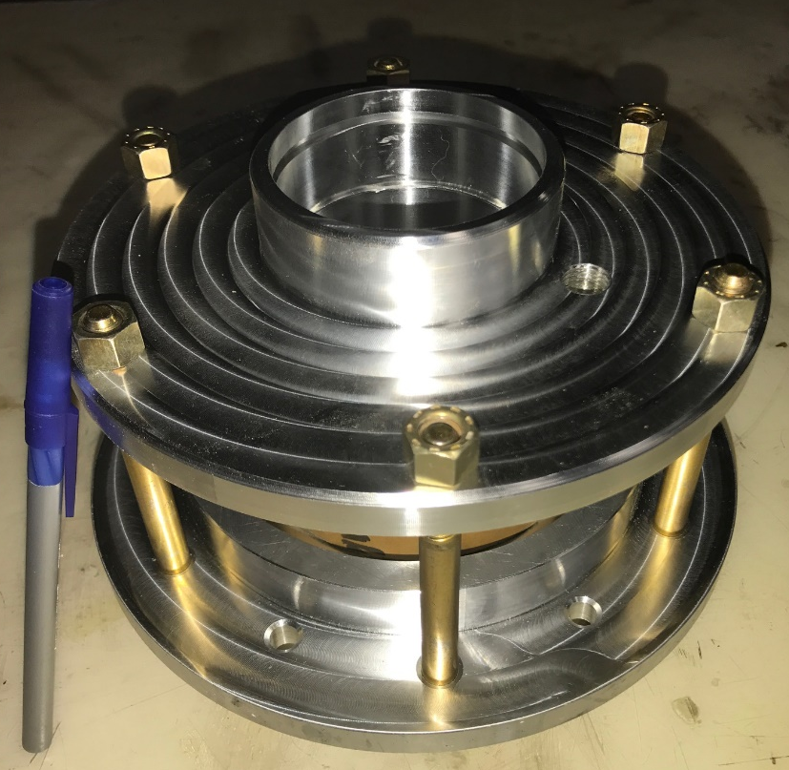
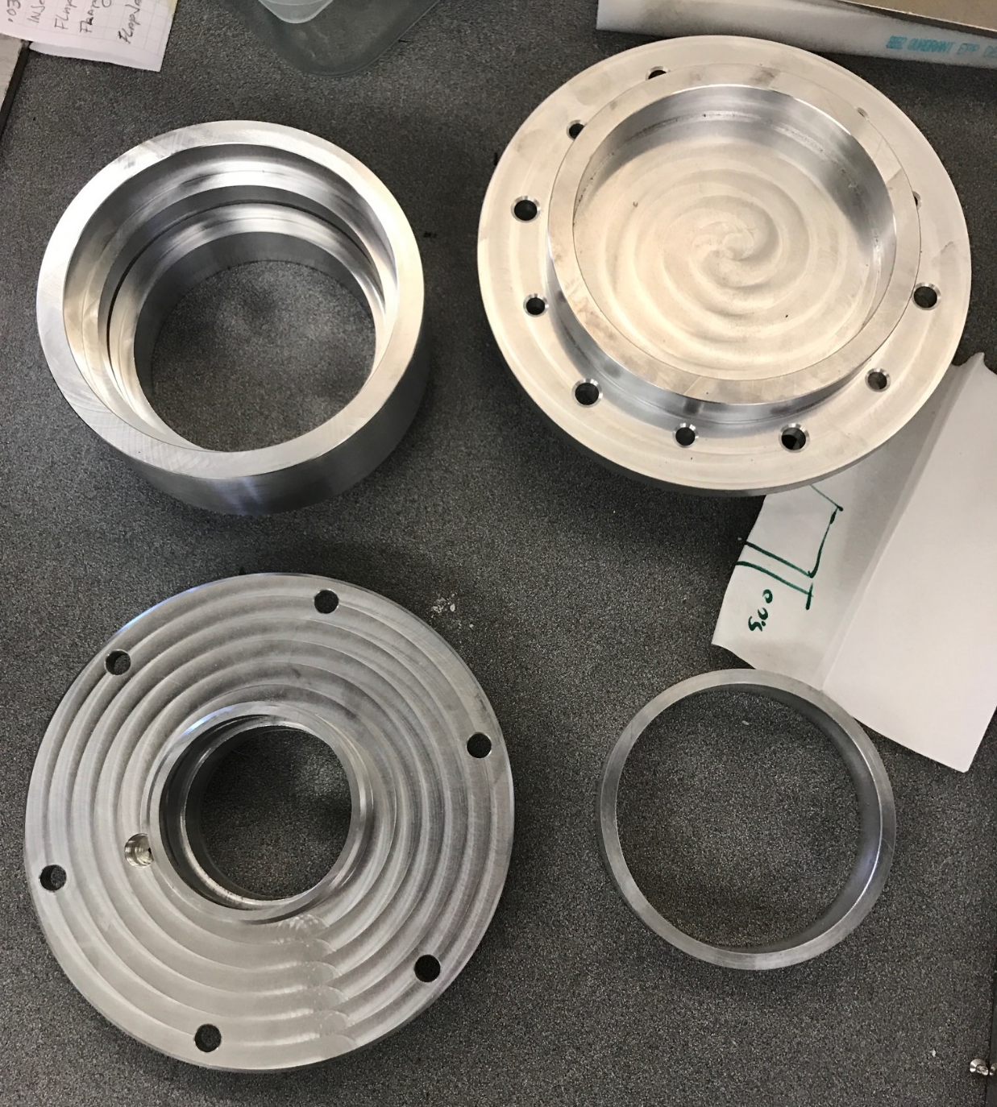
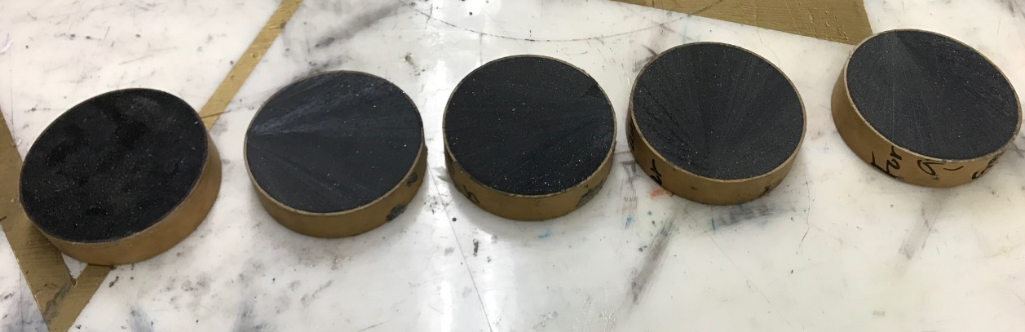
Motor Fabrication

Slide 9
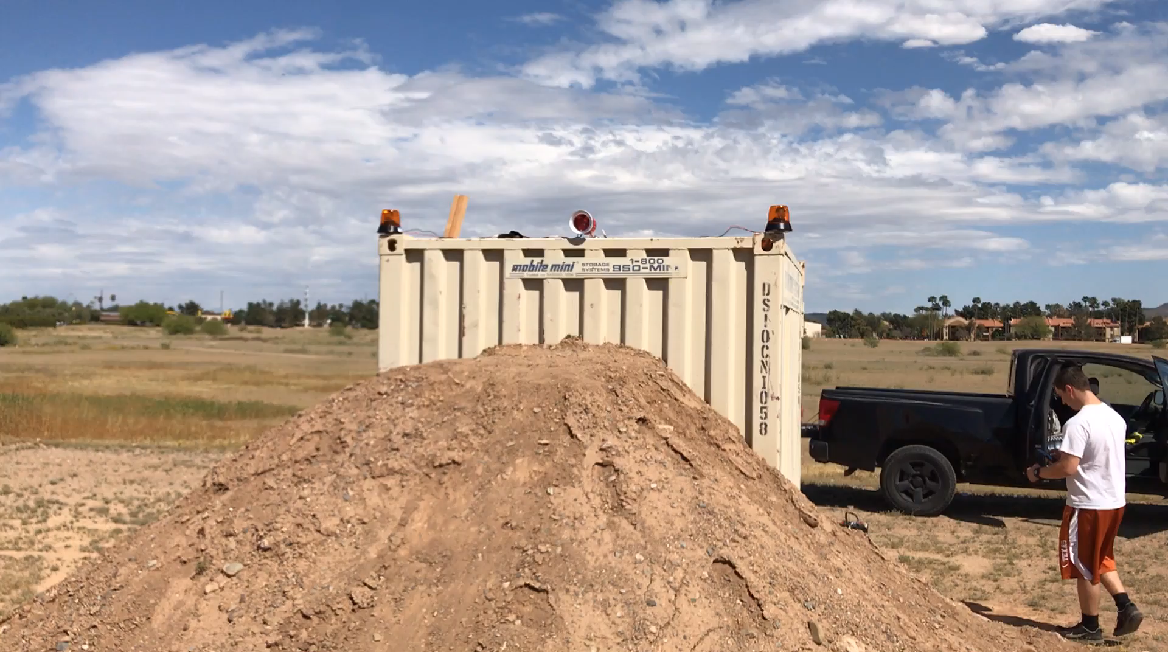
West Campus Testing Shelter

Slide 10
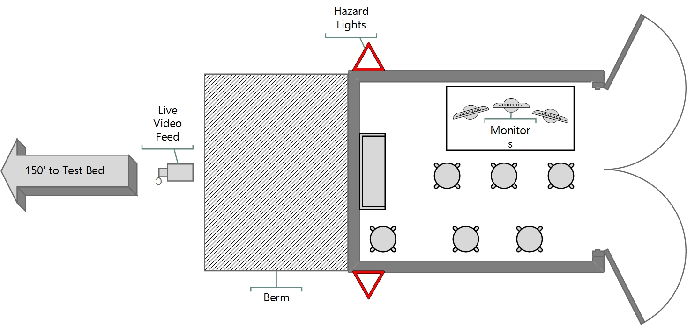
West Campus Testing Site Development
Testing procedures facility design based on DoD and Military Specifications:
AIR FORCE SPACE COMMAND MANUAL 91-710 VOLUME 3
  RANGE SAFETY USER REQUIREMENTS MANUAL VOLUME 3 LAUNCH VEHICLES, PAYLOADS, AND GROUND SUPPORT SYSTEMS REQUIREMENTS
DoD 4145.26-M
  DOD Contractor’s Safety Manual For Ammunition and Explosives

Slide 11
Acknowledgments
NASA Space Grant
My mentor: Dr. John Rajadas
The members of Daedalus Astronautics and our faculty advisor Dr. Valana Wells

